Slide 1
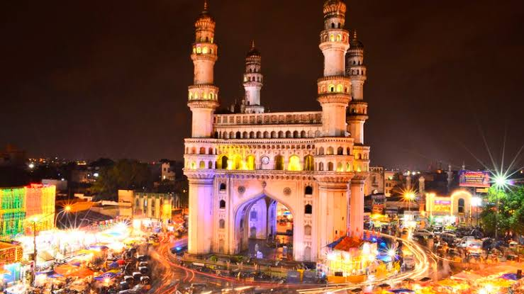
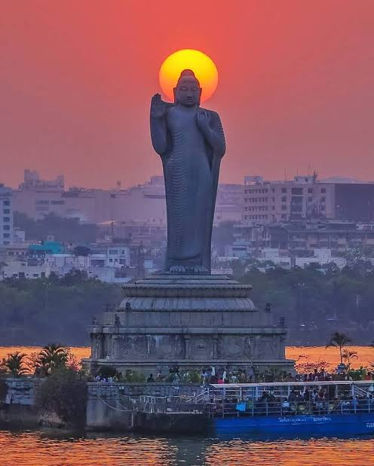
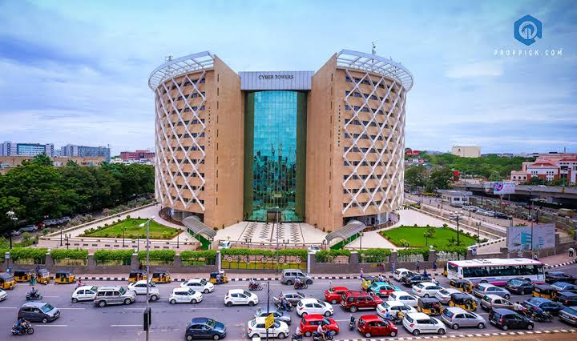
PPT PRESENTATION
HYDERABAD
(Bhagyanagaram)
28/04
G AMARNATH
19261A0470
2020

Slide 2
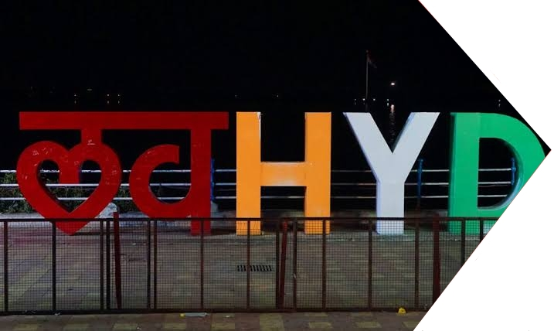
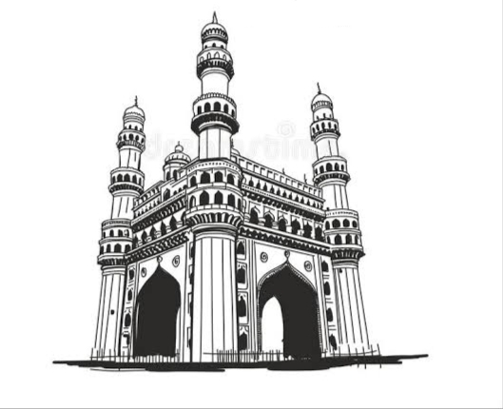
Contents
01 Tourist Attractions
02 Food
03 History
04 Geography
05 Special's of Hyderabad

Slide 3
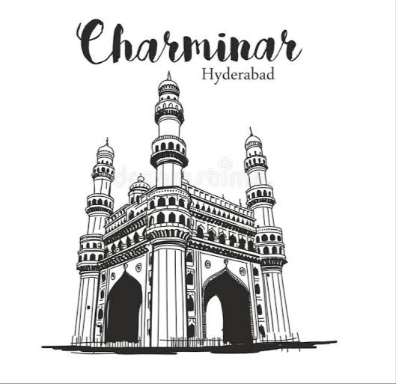
HYDERABAD
Population : 10,004,000
Population density : 10,477/km²
Area : 7,257km²
Literacy : 82.96%
Average Temperature : 30°C
Climate : Semi-arid climate (tropical wet and dry)
Language : Telugu, Urdu, Hindi
Notes:
The city is one of the 3 most important cities in the southern India & holds an important position on the tourist map of India. Fourth largest in the country & legendary in terms of history, culture & technical progress. Summer(March-May) : 36-40°C Monsoon(June-September) : 26-34 °C Winter(October-February) : 18-28°C

Slide 4
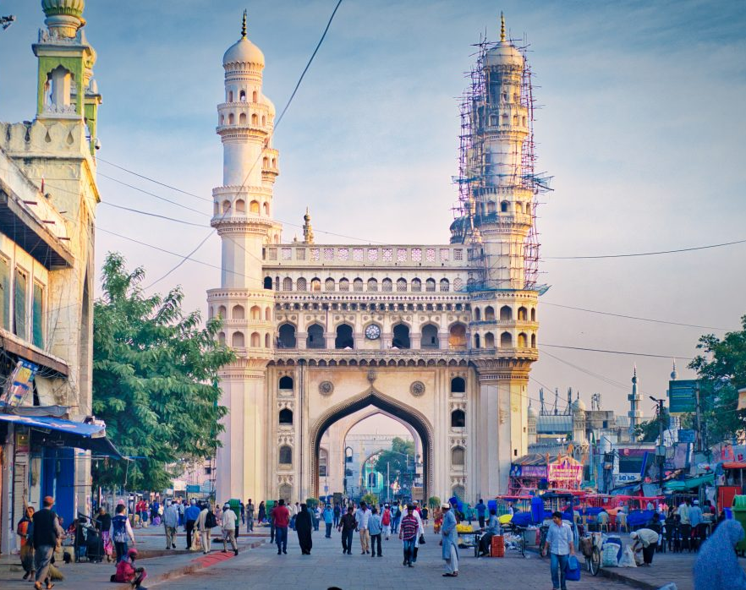
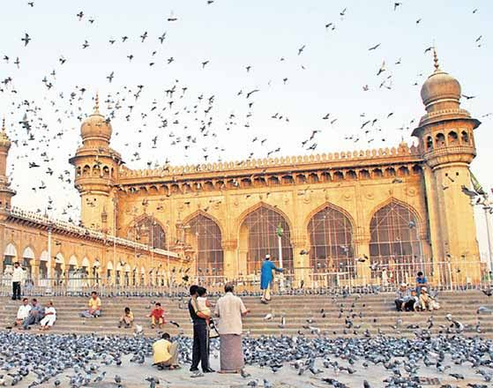
Charminar
Mecca Masjid
01
Tourist Attractions
It is built by Mohammad Quli Qutub Shah as a memorial for plague victims. Built in 1951 AD.
Mecca Masjid was built 400 yrs back during the reign of Sultan Muhammad Qutub Shah, the 6th Qutub Shahi Sultan of Hyd.
Notes:
Mecca masjid Mohammad Qutub Shah personally laid the foundation stone of the 'mosque'. More than 8000 workers were employed to built the mosque. Charminar Charminar in most occasions is used to represent the city & the state & is hailed as a unique Deccan Monument.

Slide 5
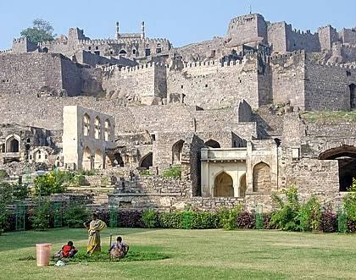
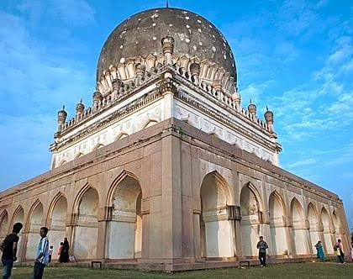
Golconda Fort
Qutub Shahi Tombs
Golconda Fort is one of the most magnificent fortress complexes in India.
Built in 13 century.
8 Gates and 87 bastians.
Home to various Tombs dedicated to Rulers of Qutub Shahi dynasty. These are the Deccan achitecture.
Notes:
Golconda Fort In the 13 century Golconda Fort was built by the Kakatiya Kings. The existing structure was later built by the Qutub Shahi Kings into a massive fort with granite walls having 8 Gates and 87 bastians. Spread upto 7 km, in circumference over a span of 62 years. Golconda Fort, popularly known in Telugu as "Golla Konda", which means "Shepherd's hill". Seated on a hill on one side and spiralling fort on the other side, it's location and internal design made it one of the strongest forts in India. Tombs located at Shaikpet, near Golconda Fort. with large minarets, huge domes, delicate marble designs & multiple inner passages.

Slide 6
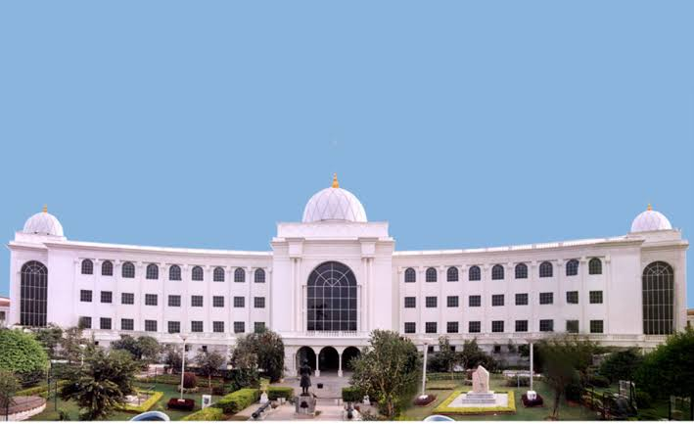
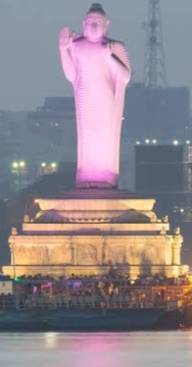
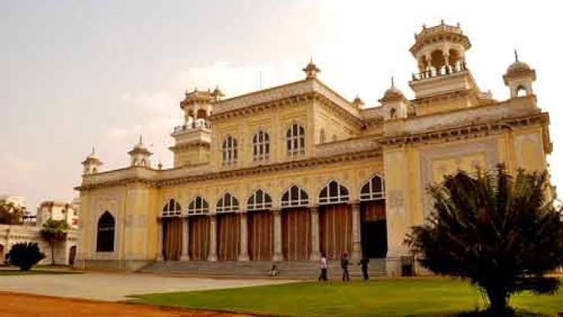
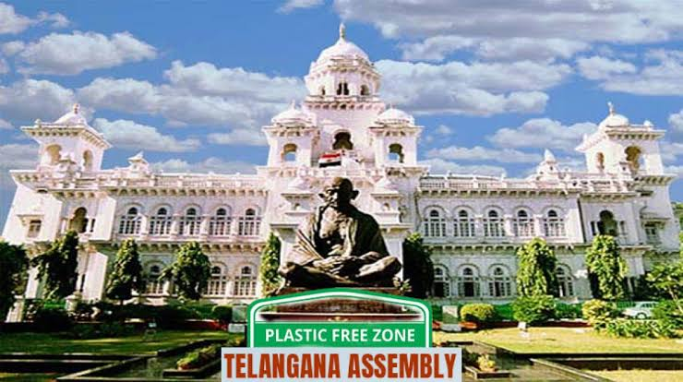
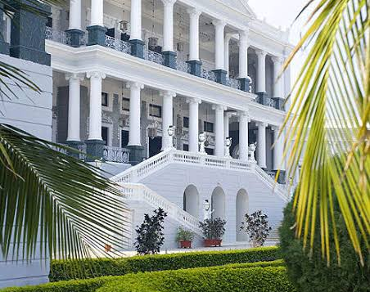
Some other important places of Hyderabad are,
Nehru Zoological Park
Lumbini Park
Jala Vihar
Wanderla
Tank bund
Hussain Sagar lake
Botanical gardens
Shilparamam
Falaknuma Palace
Chowmahalla Palace
Salarjung museum
Buddha statue
Birla mandir
Hitech city
Ramoji Film city
High court
State assembly
Notes:
falaknuma palace This is built by an Italian achitect through one of the paigah nobles, Nawab Viqar al-Umra' complete in Italian marble. It has now been undertaken by the Taj group to develop this as Heritage Hotel. Ramoji filmcity The Ramoji filmcity situated in Hyderabad, at 1666 acres. It is the largest integrated film city in the world. It is also a popular tourism and recreation center, containing both natural and artificial attractions including an amusement park. Salarjung museum It is the third largest museum in India and It is one of the largest one man collections in the world.

Slide 7
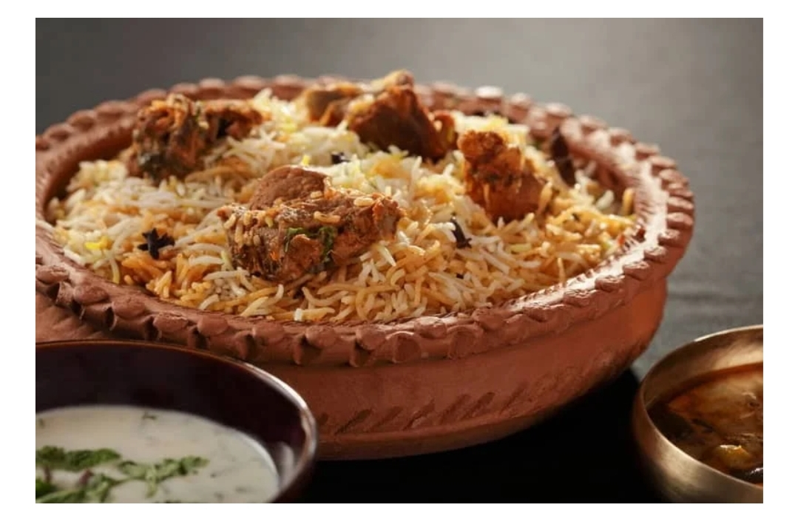
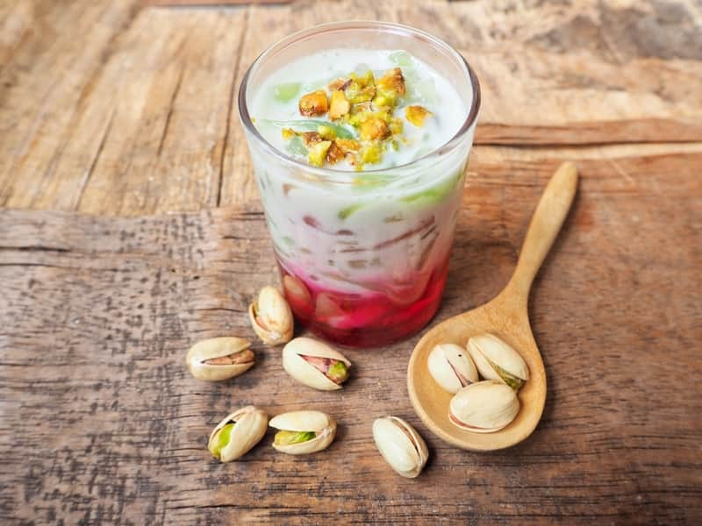
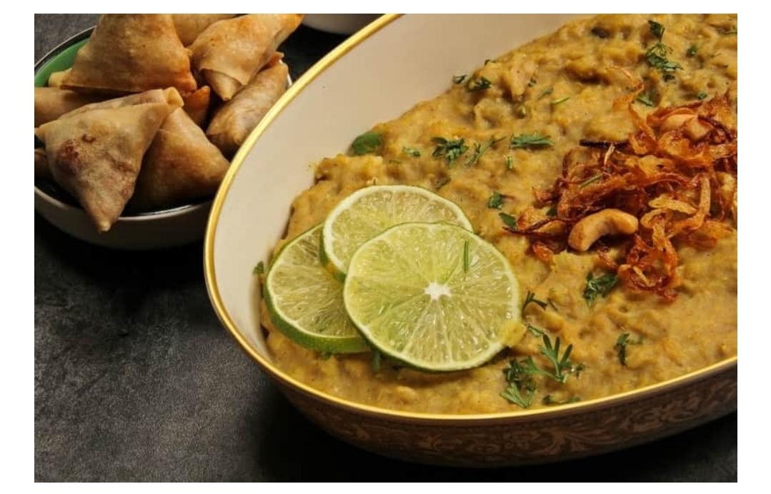
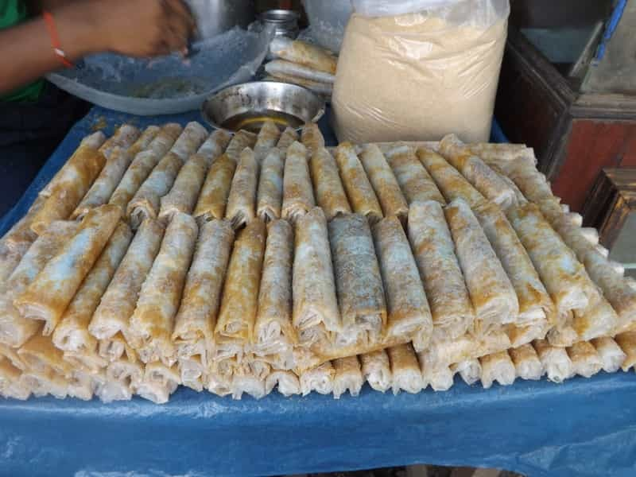
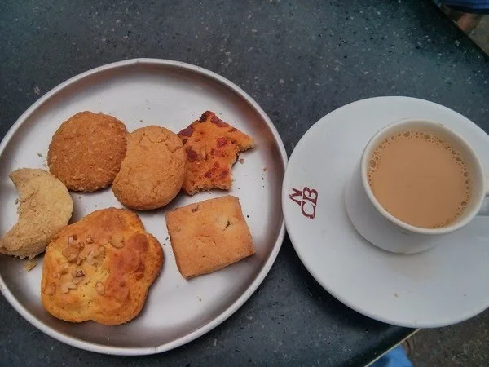
The best Food in Hyderabad
Hyderabadi Biryani
Hyderabadi Hallem
Hyderabadi Marag
Irani chai
Osmania biscuits
Kebabs
Mutton Dalcha
Desert Food items
Keema samosa
Dum puktht
Falooda
Sheer korna
Mirchi ka Salam
Mirchi bajji
Pesarattu
Pootharekulu
02

Slide 8
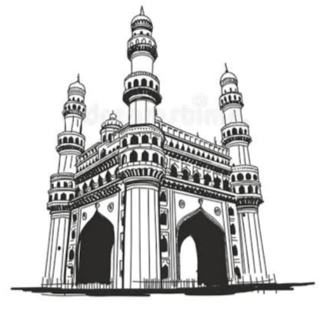
History of Hyderabad
03
In 1589, Md Quli Qutub Shah, selected the present site of the city and named it "Bhaganagar" or "Bhaganagar" after Bhagmathi, a local nautch girl with whom he had fallen in love.
According to another source, the city was named after Haidar, the son of Quli Qutub Shah.
Andrew Peterson, Islamic architecture, says the city was originally called Bhaganagar(city of gardens).
Notes:
The history of Hyderabad begins with the establishment of the Qutub Shahi dynasty. Quli Qutub Shah seized the reins of power from the Bahamani kingdom in 1512 and established the fortress city of Golconda. Mohammad Quli Qutub Shah to venture outward to establish new city with the Charminar at its centre and with four great roads fanning out four cardinal directions. She converted to Islam and adopted the title Hyder Mahal. The city was renamed Hyderabad in her honour. Muhammad Quli Qutub Shah, the ruler of Qutub Shahi dynasty,

Slide 9
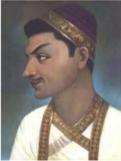

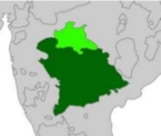
Qutub Shahi dynasty
Nijams kings
Hyderabad dynasties and their period of time
( 1589 -1720 )
( 1720 - 1948 )
Quli Qutub Shah
Fifth Sultan of Qutub Shahi dynasty
Largest princely state in India

Slide 10
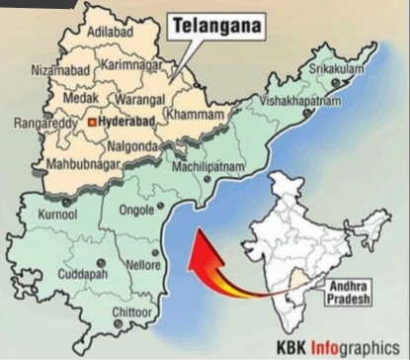
Hyderabad after Independence
Hyderabad became the capital of Andhra Pradesh.
On 2 June 2014, AP was split off to form a new Telangana state, and that Hyderabad city would be the capital city. While the city would remain the capital of AP for no more than 10 years.
Notes:
Many companies, industries, factories were established. Hyderabad developed in all sectors.

Slide 11
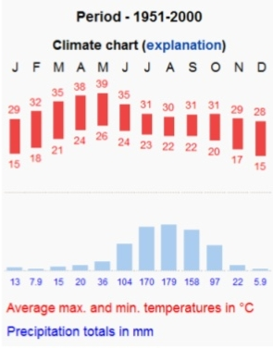
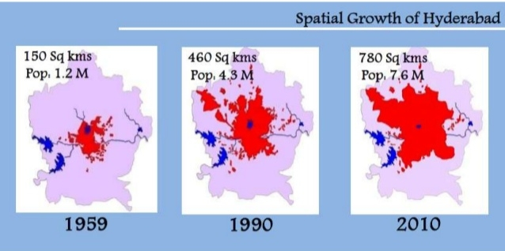
04
Geography
This city lies in the Deccan Plateau Avg height of 536m above MSL.
This city is located at the coordinates 17.37°N 78.48°E
Hussain Sagar lake, built during the reign of the Qutub Shahi dynasty, was once the source of drinking water for Hyderabad.
Notes:
Metro rail Railway network Rajiv Gandhi international airport ORR The Climate change in Hyderabad is explained by the chart given beside.

Slide 12
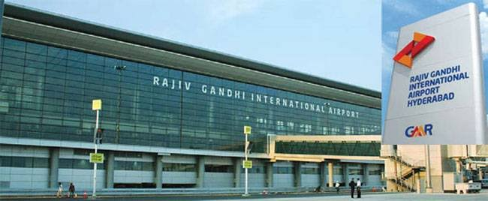
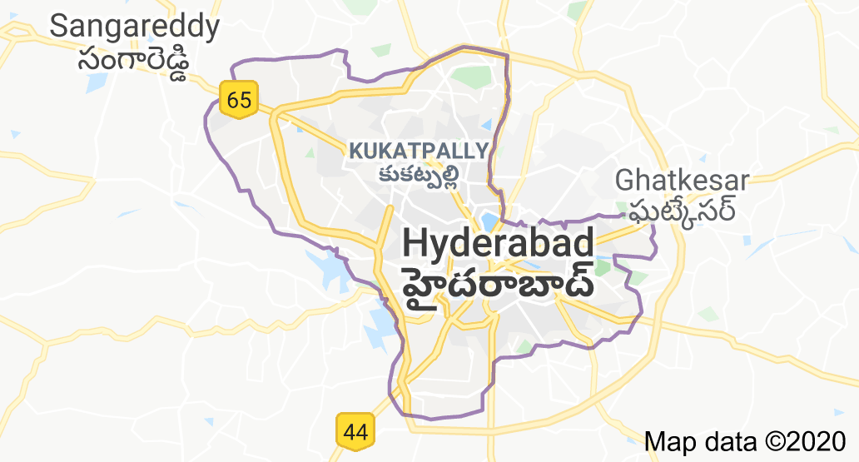
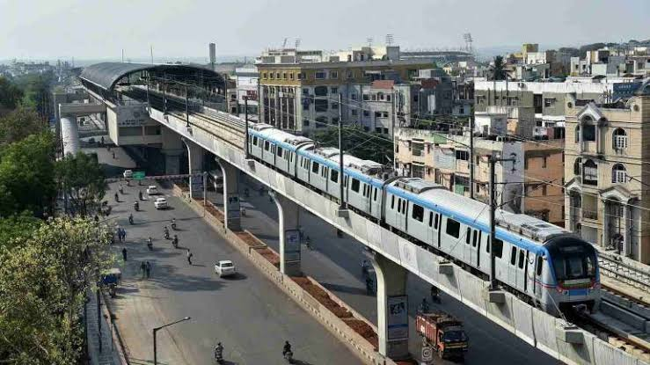
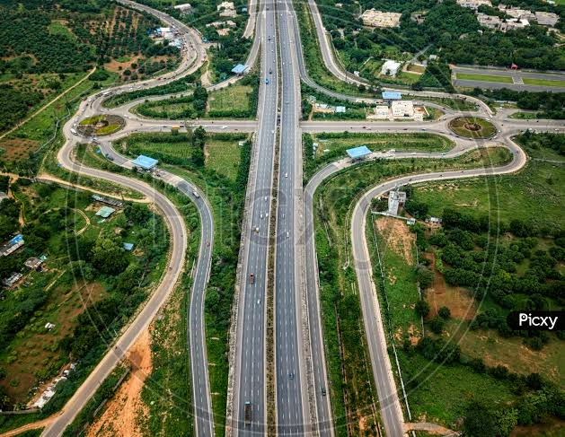
Growth of population in Hyderabad
Census | Growth in %
1971 | -
1981 | 41.8%
1991 | 20.2%
2001 | 18.9%
2011 | 87.2%
Notes:
Secundrabad Railway Station It is the headquarters of the South Central Railway. There are also many universities, all types of research centres, institutions.

Slide 13
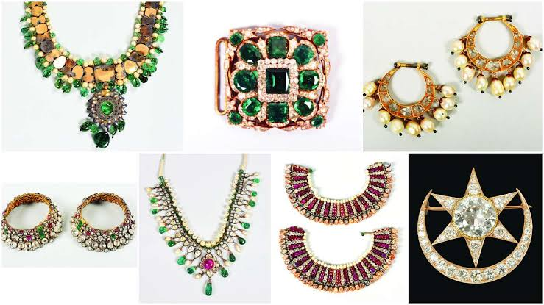
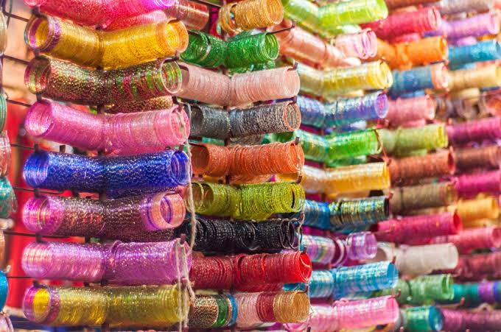
05
Specials of Hyderabad
Pearls & Jewellery: Carrying on the ancient prosperous pearl trade, of the expensive, the exclusive, & the rarest in the world, Hyd still remains the pearl capital.
Lac bangles: Hyderabad itself is known for its bangles made of glass and lacquer and studded with stones.
Notes:
Bangles The place to shop for bangles of the largest variety and at reasonable prices is the Laad Bazaar adjacent to the historic charminar.

Slide 14
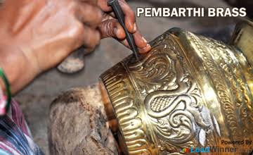
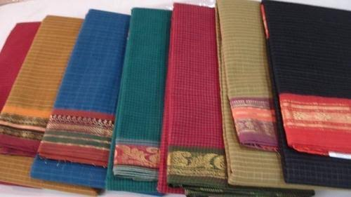
Handicrafts: Bidriware, 'Kalamkari' paintings from Cheriyaland, brass metalware from Pembarti are some of famous work.
Handlooms & sarees: The magic of the hands: Dharmavaram silk sarees, Narayanpet sarees, pochampally sarees, Gorgeous Gadwal.
Notes:
Handicrafts: Handicrafts & toys are among the most Sought-after pieces for the shopper in Hyd. Handlooms Hyderabad has innumerable showrooms that showcase the most distinctive heritages of the city-handlooms.

Slide 15

THANKS
🇮🇳JAI HIND

